Slide 1
Welcome to SDAO’s 1st Thursday Lunch and Learn
Upcoming webinars:
February – Discussion of the Oregon OSHA Heat and Smoke rules
March – Accident Investigation
April – Hazard ID
May – Discussion about an effective safety committee
Notes:
Welcome to SDAO’s first lunch and learn webinar, My name is Christian Boyd and I will be your moderator for todays Webinar.
Every first Thursday of the month, we will be offering a lunch-time webinar to our members about various topics including risk management, claims, property, and more. Today’s webinar will be an informational session about safety committees. This will be the beginning of a four-part series on safety committees. The flowing three sessions will be on accident investigations, hazard identification and effective safety committees..

Slide 2
Questions and Follow up
You can send questions in throughout the webinar using the question box in the GoToWebinar app
We will follow up via email with all attendees with questions we receive and answers to them
Notes:
Please send in your questions throughout the webinar using the question box on the gotowebinar app and we will attempt to answer them as time allows. There is a good chance we may not get to all the questions today so we will be sending out an email to all attendees with the questions we receive and the answers to those questions. Just so you know there is a bit of lag time when you send the question and when the presenter gets the question. If you have a really complex situation, please email riskmanagement@sdao.com and we will contact you directly.
Thanks for attending the first of many SDAO lunch and learn style webinars. I will now turn it over to today's presenter Jason Jantzi.

Slide 3
Safety Committee Overview presented by the Risk Management Department riskmanagement@sdao.com
Notes:
Welcome to the first of 4 SDAO webinars on the topic of safety committees. As Christian mentioned we will be holding a monthly webinar and discuss a wide range of topics. If you have an idea for us, please let the risk management team know via email at riskmanagement@sdao.com
Now let’s get started with the safety committee overview.

Slide 4
Overview
Who should have a safety committee?
Requirements
SDAO Risk Management Services
Questions?
Notes:
Review the goals of class.
Please send in your questions throughout the gotowebinar app and we will attempt to answer them as time allows. Just so you know there is a a bit of a lag when you send the question and when the presenter gets the question. If you don’t get your answers during the webinar or you have a really complex situation, please email riskmanagement@sdao.com and we will contact you directly.
Thanks for attending the first of many SDAO lunch and learn style webinars.

Slide 5
What’s the
porpoise?
Purpose?
Notes:
I know, bad dad joke…but let’s start here.

Slide 6
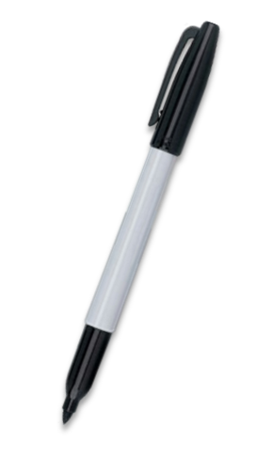
The purpose of the
safety committee…
Bring workers and
managers together…
Notes:
What is the purpose of the safety committee? Straight out of the introduction to the Safety Committee and Meetings rule: “the purpose of safety committees and safety meetings is to bring workers and management together in a non-adversarial, cooperative effort to promote safety and health.”

Slide 7
Promoting health
and safety…
Notes:
This group is your best advocates for promoting safety and health in the workplace. Health and Safety and job satisfaction go hand in hand. It is not the safety police and should not be used to enforce your organization’s policies. That is the role of your supervisors and may actually harm the reputation of your safety committee.

Slide 8
Notes:
In 2012 Drexel University developed a validated survey tool that showed the link between safety and organizational outcomes, such as job satisfaction and burnout. So if you don’t think that the safety committee can have an impact on your organization beyond health and safety think again.

Slide 9
Who should have a
safety committee?

Slide 10
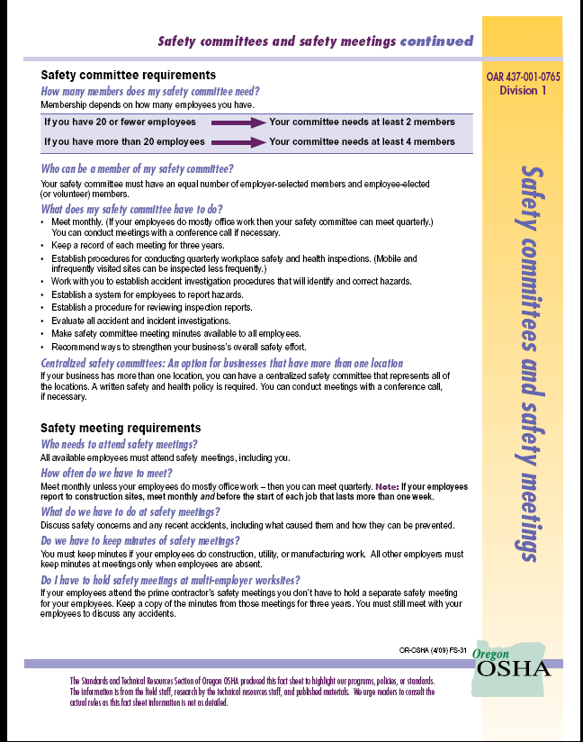
OR-OSHA Fact sheet
Notes:
This is the best source of information to help you determine if you can do a safety meeting. Bottom line is everyone can do a safety committee, but there may be times when a safety meeting is the best for organization. You can find this an many other resources on the Oregon OSHA website under the A-Z topic list.

Slide 11
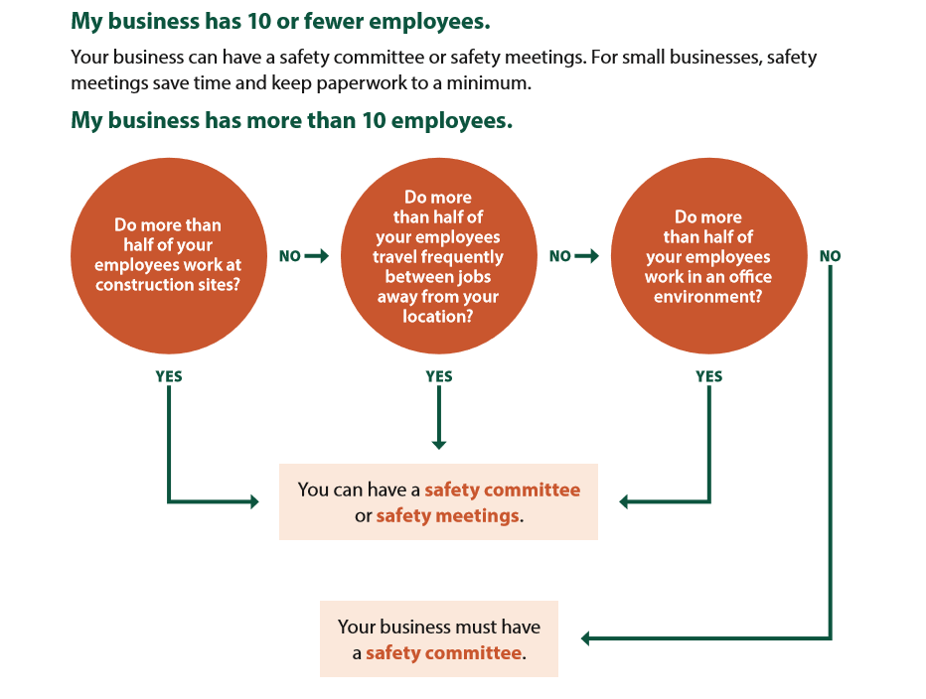
Notes:
Since everyone can have a safety committee the only decision to make is whether you can have safety meetings instead. This flow chart will help you determine if it’s legal for you to do so. For 10 or fewer employees, you can have both. Figure out what works best for you and make it happen.
If you have more than 10 employees ask your self these questions. Do more than half of your employees do the majority of their work outside of an office? IF they do then you can do both a committee or a meeting. Do more than half of your employees work in an office? Then you can do both.

Slide 12
Only retail and manufacturing…
Notes:
If you boil it all down, the only industries that are saddled with only having a committee are retail and manufacturing establishments.

Slide 13
Other committee concepts…
Notes:
There are other ideas for having a committee. Like a hybrid committee that morphs the concepts of a committee and meetings. Also a centralized committee, which is what SDAO does. If you have these or want to explore these ideas, contact the risk management department.

Slide 14
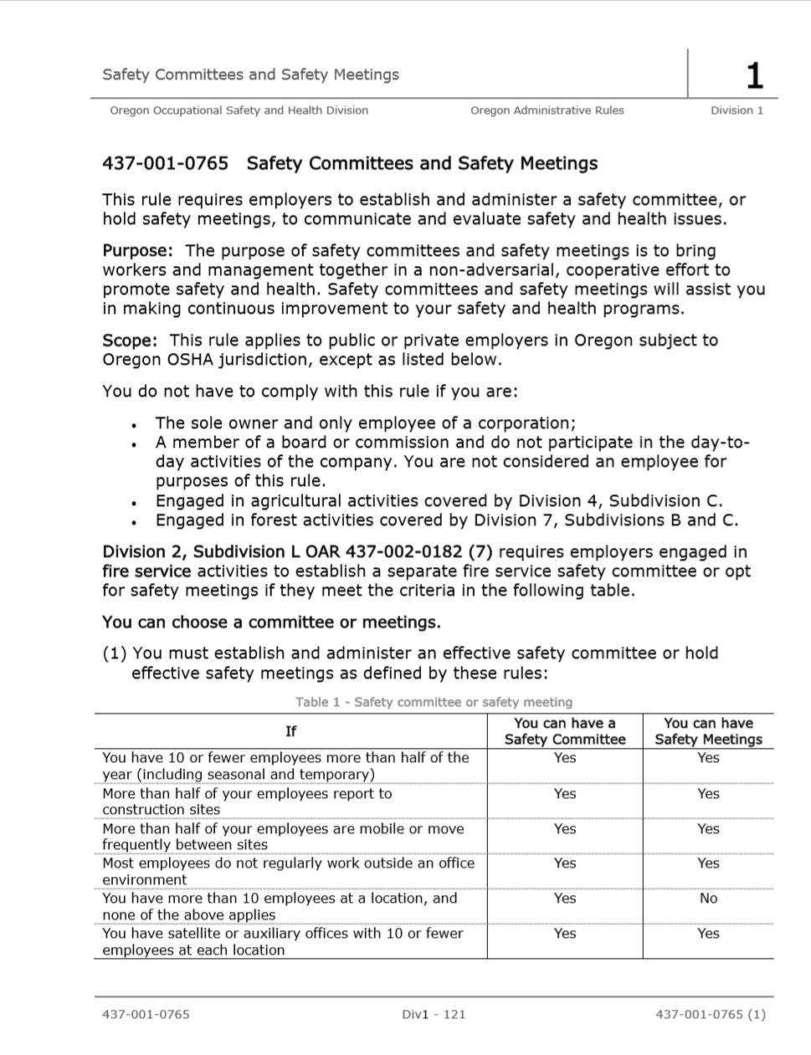
Notes:
So you have chosen to do a safety committee, what’s the rules?

Slide 15
The rules…
OAR 437-001-0765
Notes:
This Oregon administrative rule is the rule for safety committees and safety meetings.

Slide 16
The requirements…
riskmanagement@sdao.com
Notes:
Oregon OSHA has a list of requirements that we are going to distill down in the next few slides. As always, read the rules if you want to know all of the requirements or contact risk management for help.

Slide 17
Members…
Volunteers are best
Can be selected
Represent major activities
Notes:
The members of the safety committee should be employees and management members that volunteer to help out. If the organization can’t find volunteers committee representatives can be chosen. The management team can select their representative and the employees can select theirs if needed. The members should represent the major activities of your organization. For example: Fire Districts, paid staff and volunteers; Library districts, Librarians, IT, warehouse

Slide 18
Members…
Agree on chairperson
Be trained
Notes:
The members of the safety committee must agree on who will be the chairperson. It doesn’t need to be an election, you can simply come to consensus about who will lead the group. Also you must receive training. The two required topics are how to identify hazards and the principles of accident investigation. You can do these trainings yourself or take advantage of the resources SDAO has to help you with them. There will be upcoming webinars on these topics.

Slide 19
Members…
Minimum of 2 members
Equal numbers
Notes:
For organizations with 20 or fewer employees you can have a committee with 2 members, although I might recommend having a safety meeting at this point, but we can talk about that at a later date.
If you have more than 20 you must have a minimum of 4 members. And remember they should represent your major activities. Also keep in mind that Oregon OSHA wants you to have equal representation from management and the labor force. So those 4 members would be at least 2 management and 2 labor.

Slide 20
Meetings
Meet monthly
Conference call
Notes:
The meeting requirements are fairly simple. Meet monthly. If your district does nothing but office work you could do quarterly meetings, but check with risk management first.
To make thing easier you can conduct your meetings via conference call or video conferencing. Take advantage of the technology that’s out there.

Slide 21
Meetings
Keep a record – 3 yrs
Provide minutes
Notes:
You must keep a record of your meetings. Those minutes are to be kept for at least 3 years. AND all of your employees must have access to them. This is again a great way to take advantage of technology. Internal web pages, emails, etc. can be used to disseminate the minutes.

Slide 22
Minutes
Issues discussed
Trackable recommendations
Notes:
Your minutes need to capture certain things. They need to have the date and names of those attending. Any of the issues that you discussed and the resolutions you came to. If you do make a recommendation, those need to be tracked to completion.

Slide 23
Inspections…
Committee might not have to do them…
Notes:
This is the best misconception that I have heard about in my 15 years working for Oregon OSHA. The committee has to do the inspections. Well actually the rule requires that the committee “establish procedures for conducting workplace inspections…” and that “persons trained in hazard identification conduct those inspections.” My recommendation is to have some of the committee do the inspections with others. This becomes a great opportunity to train future committee members as well as see how the culture of the organization is doing.

Slide 24
Inspections…
Quarterly may not be enough…
Notes:
This is another one that always got me strange looks when I started talking. Even though the safety committee rule requires a quarterly inspection, my guess is that you, air quotes, “inspect” your facilities more than quarterly, unless it’s a pump house 17 miles from the nearest road. That’s good because there’s another rule that OSHA has that requires inspections of your facilities, “as often as necessary” The typical problem with these inspections is that they aren’t documented.

Slide 25
Inspections…
OAR 437-001-760(7)(a)
Notes:
“All places of employment must be inspected by a qualified person or persons as often as the type of operation or the character of the equipment requires.” The typical problem with these inspections is that they aren’t documented. But if you began to document them those would take the place of the safety committee inspections. The benefit of this is that the safety committee can now do oversight. Plus, it gets more people involved, which helps all of us comply with one of the self-insured rules. But now I’m just becoming OSHA nerdy, if that’s possible. Needless to say, doing this helps on many fronts.

Slide 26
Accident investigations…
Establish procedures
Written recommendations
Notes:
This is another area of safety committee rules that has gotten twisted up. Once again the safety committee is tasked with developing the process that will be used in the event of an accident. Part of this process has to be making recommendations that are followed to completion. The committee should be the oversight group that reviews all of the safety items, including accident investigations and makes recommendations.

Slide 27
Accident investigations…
Review the investigations
Recommend fixes
Notes:
The committee is to review all the accident and incident investigation that your organization does. After ensuring the investigation gets to the root causes, the committee needs to make recommendations that help prevent these accidents from occurring again. Those root causes are most likely related to training, supervision, or the availability of resources. Therefore the committee should be looking to recommend things that correct deficiencies in these areas.

Slide 28
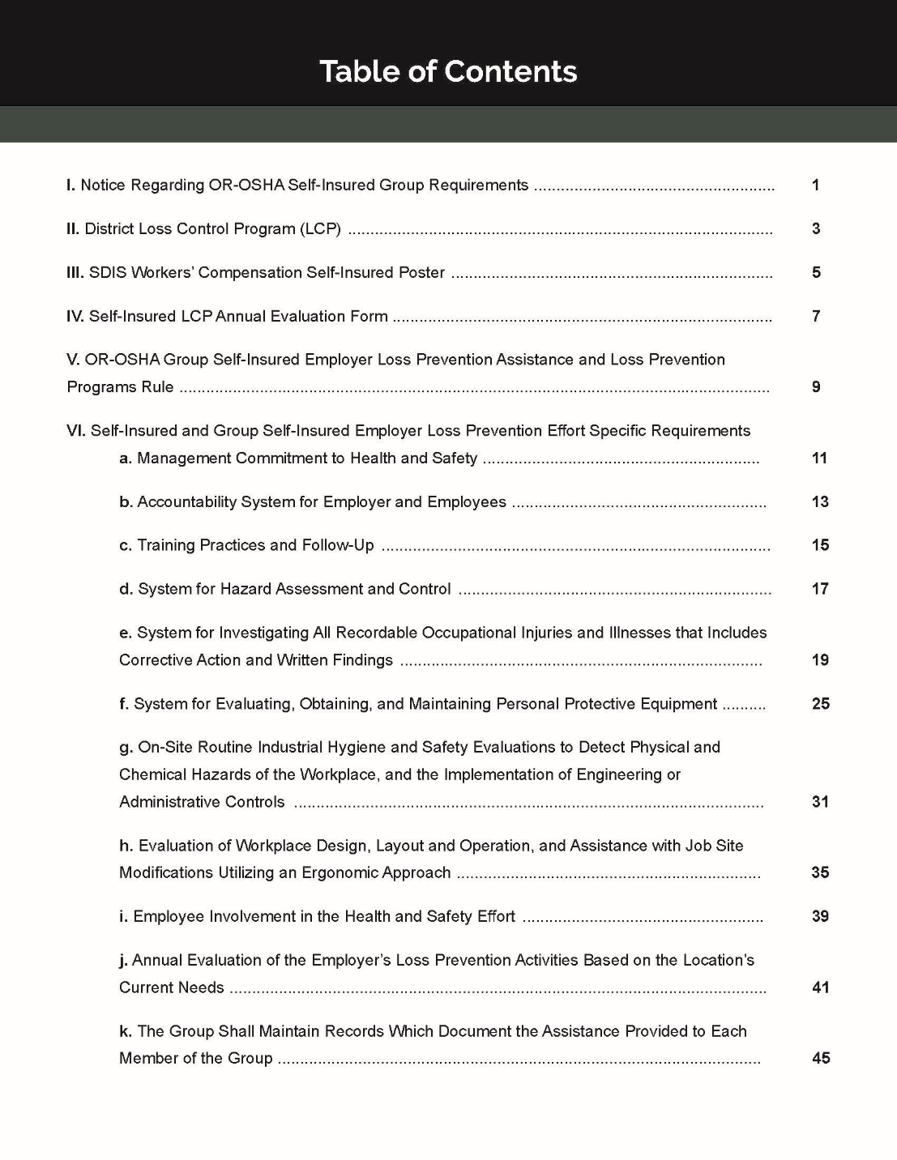
Notes:
Many of these safety committee rules are echoed or complimented in the self-insured rules that govern how the SDIS workers compensation group operates. This toolkit will be made available for all districts in the workers comp pool and covers all the required items that Oregon OSHA mandates.
Key points for members to know about:
Reviewed by legal counsel
Exceeds the OR-OSHA requirements
Helps to tie together all the OR-OSHA requirements that they are already doing
Designed for 3-ring binder so they can update easily
Review table of contents

Slide 29
Send additional questions to:
riskmanagement@sdao.com
Notes:
Now that you have an understanding of the safety committees purpose you may have questions. Go ahead and send your questions in to us so we can address them before the end of the webinar. While you are doing that I am going to go over some of the services that the risk management department has to offer.

Slide 30
Onsite visits
Industrial Hygiene
Infrastructure Inspections
Training
Consulting resources
Notes:
Here are some of the services that the SDAO Risk Management department can offer you…
Onsite training visits for safety committee walk throughs addressing employee safety issues
Industrial Hygiene – Indoor air quality, noise, ergonomics
Infrastructure inspections for both property and liability
Just remember if you need assistance email riskmanagement@sdao.com

Slide 31
Answers to Questions?
Risk Management Department
Legislative Program
Employee Benefits Program
SDAO Pre-loss Department
Management Consulting Services Program
SDAO Advisory Services
800-285-5461
SDAO Claims Department
800-305-1736

